Slide 1
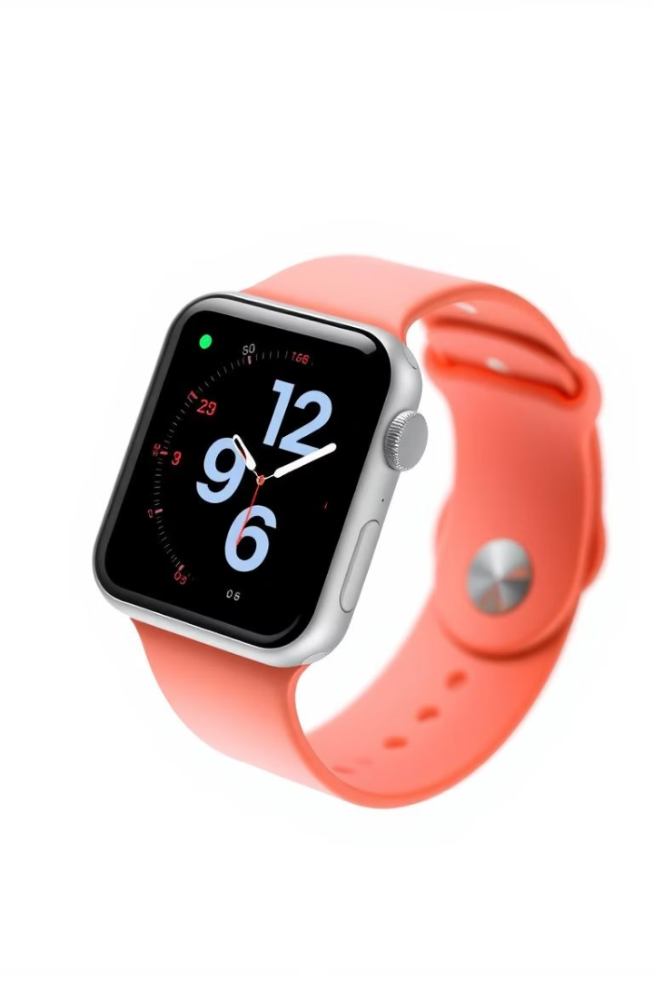
Apple Watch SE
～GPS Model ＆ 44mm Model～
35625277 Natsuki Kimura

Slide 2
Uses of Apple Watch SE
Activity Tracking
Health Monitoring
Smartphone Notifications
Apple Pay

Slide 3
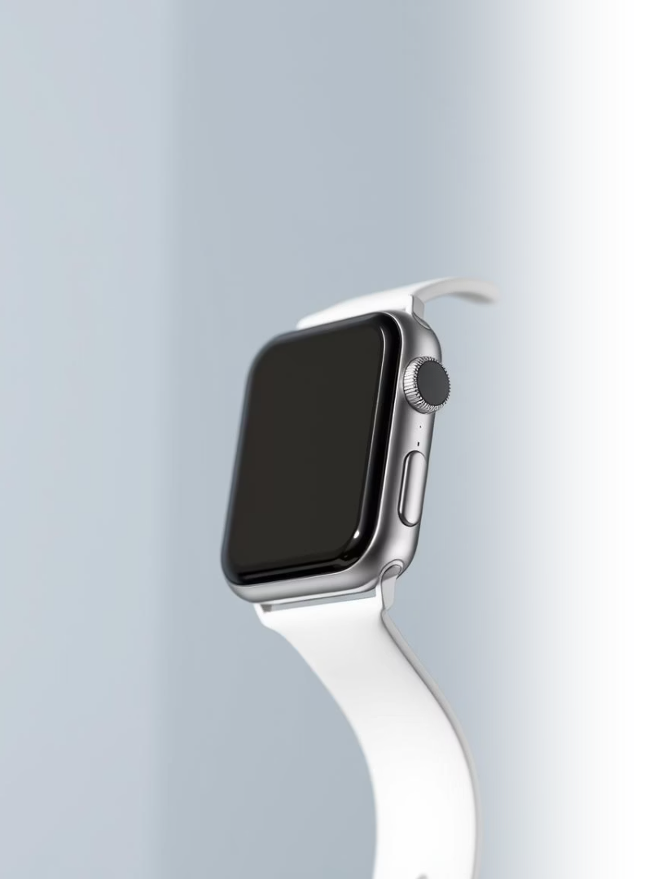
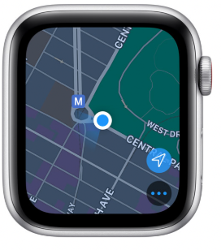
Specifications
Weight
33g
Thickness
10.7mm
Screen Size
44mm x 38mm
Battery Life
Up to 18 hours
44mm
38mm

Slide 4
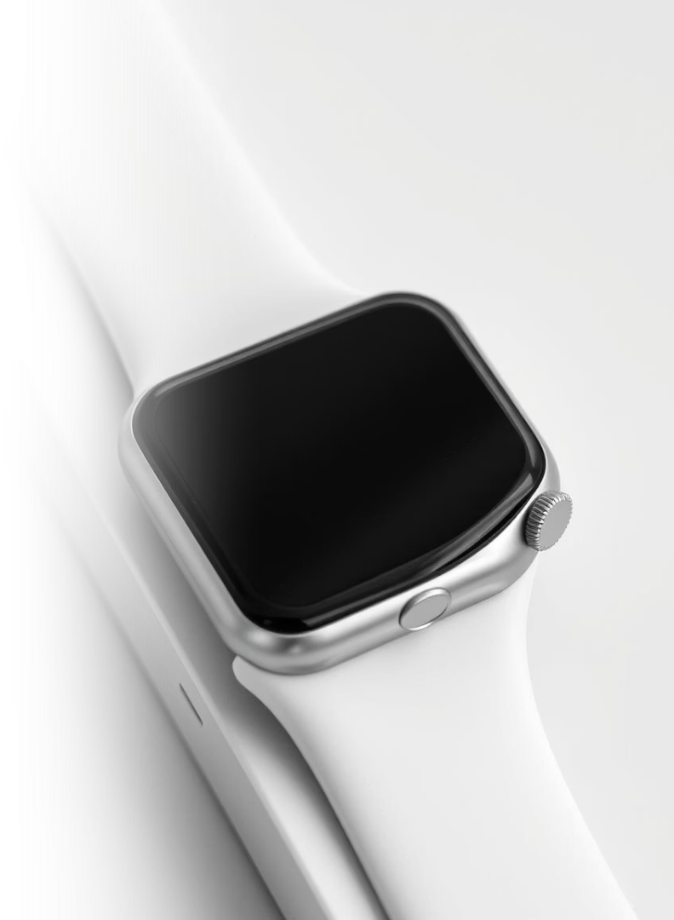
Materials
Case
Display
100% recycled aluminum
Ion-X strengthened glass
Bands
Stainless steel or silicon or nylon

Slide 5
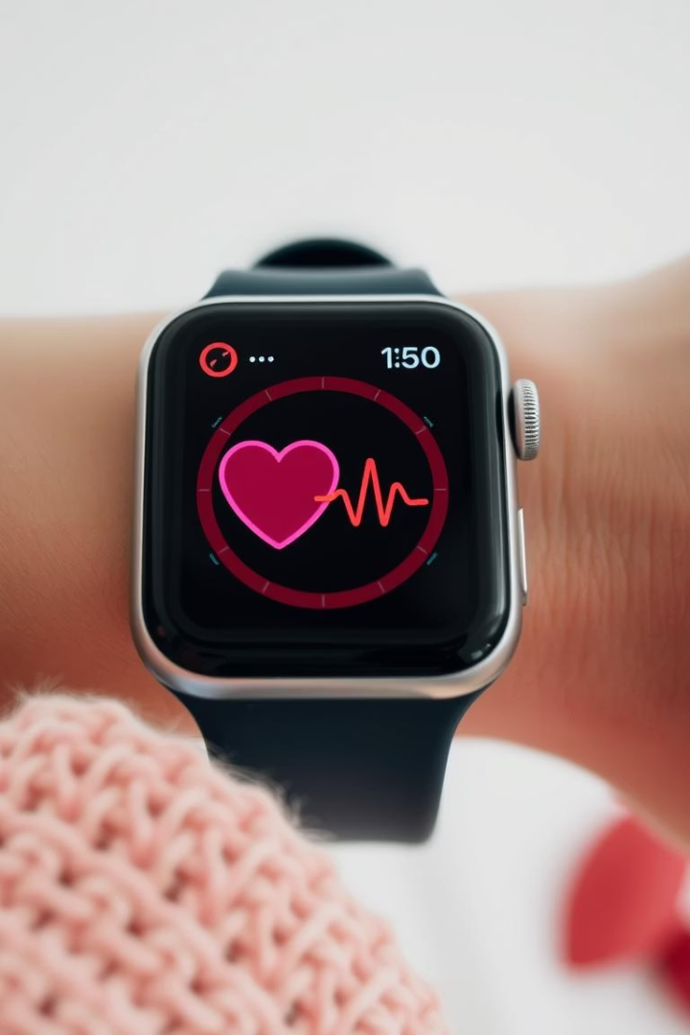
Heart Rate Monitoring
Optical Sensor
Alerts
Irregular Rhythm

Slide 6
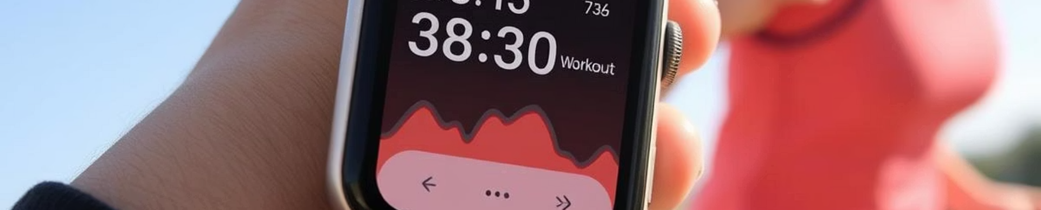
Activity & Exercise Tracking
Analysis
Motivation
GPS Tracking
Records

Slide 7
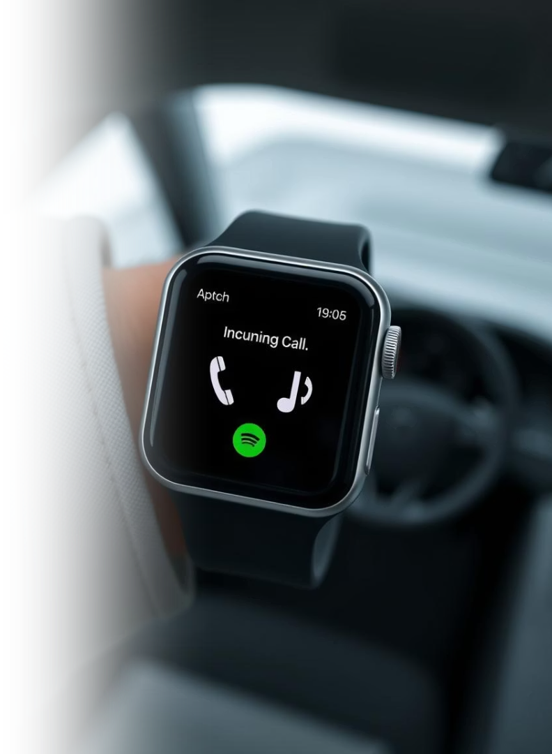



Connectivity
Calls & Messages
Siri Integration
Media Control

Slide 8




Sleep Tracking Capabilities
Sleep Quality
Heart Rate
2
3
Total Sleep
Trends
1
4

Slide 9





Apple Pay Compatibility
Payment Cards
Contactless Payments
Standalone Use
Secure

Slide 10
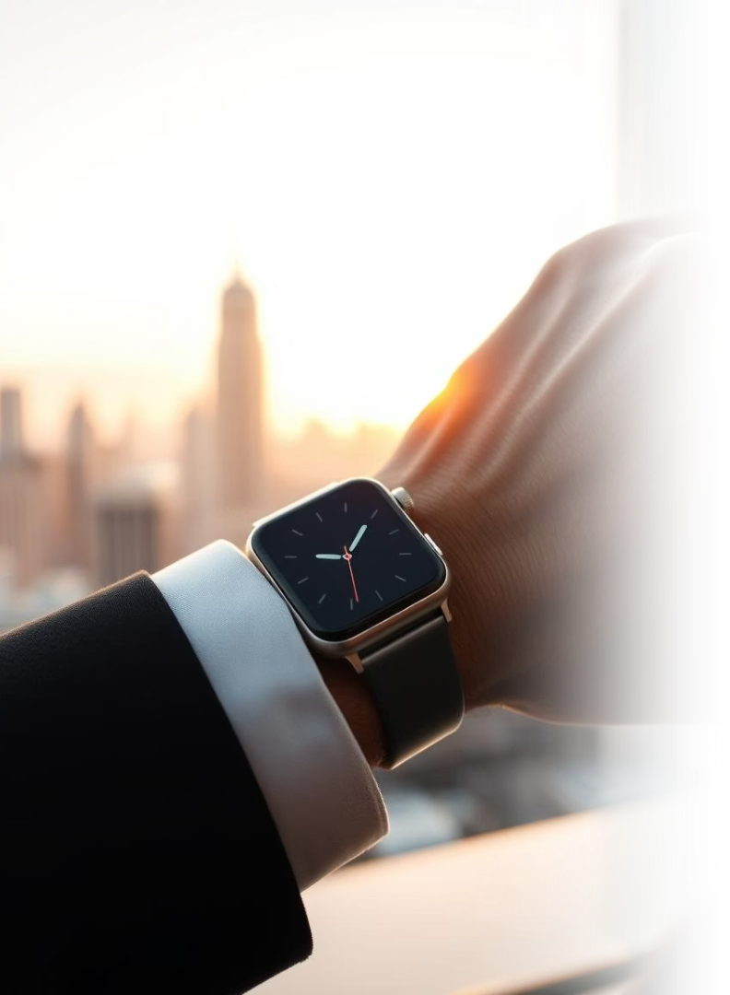
Conclusion
・ specification
・ material
・ Multiple functions

